Slide 1
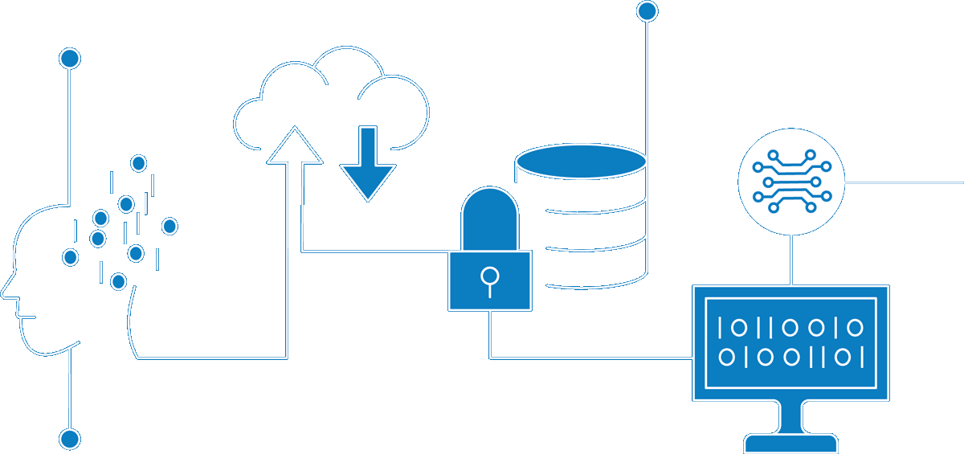
Master Data Management for UK ET/GT
Enterprise Information Architecture
Classification: Confidential
Author Nishit Ajwaliya
Date February 2021
Version v0.1
Status DRAFT

Slide 2
Contents
01 | Why Master Data Management?
 | Why Master Data Management? Business Demand for Master Data Management Enterprise Data Capabilities Modernization Enterprise Data Platform
02 | What is Master Data?
 | Meta Data, Master Data, Transaction Data Example: UK Ellipse Work Order
03 | What is Master Data Management?
 | Master Data Management Master Data Management Architecture Vision MDM High Level Architecture MDM Implementation Styles Benefits of Master Data Management Master Data Management Use Cases
04 | Roadmap
 | Data Capability Enablement Tools Roadmap Master Data Management Roadmap UK Asset Roadmap Master Data Management Vendor/Tools
05 | Questions

Slide 3
01
Why Master Data Management?

Slide 4
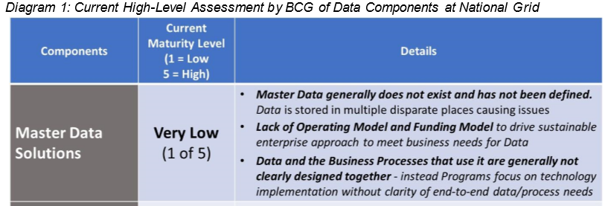
Why Master Data Management (MDM)?
As per the “Fixing Data” paper presented in April 2020 to executives by Chief Data Officer Charles Zentay, unless we “Fix Data” our security, major programs, and financial and operational performance are at risk. In addition, clean, organized Data is like a common language and underpins Business Analytics and Digital Transformation. To overcome our data problems, the key components are (i) building upon the progress of Data BMS to improve capabilities of Data Governance & Stewardship; (ii) implementing standardized Data Tools & Platforms; and (iii) driving Master Data Solutions in each major domain (Workforce, Customer, Asset, Product, Vendor, and Finance). To ensure rapid action and coordination, it is imperative to agree on a “Hub-and-Spoke” operating model, an owner to drive Master Data for each major domain, and a holistic funding model.

Slide 5
Business Demand for the Master Data Management
US Business Domain Demand​
US Customer – MDM requirement to build high quality, consistent, accurate, and complete master customer and meter data from numerous US customer systems of record like CRIS, CIS, CRM etc. and make them available to enterprise e.g. Customer Transformation, GBE, Digital Enablement (On My Way), Energy Efficiency/Clean Energy initiative, Smart Target initiative, Consolidation of Customer Data Sources to scalable centralized repository etc.
US Asset – MDM requirement to build high quality, consistent, accurate, and complete master asset data from numerous US asset systems of record like Power Plan, GIS, Cascade, Computapole, STORMS, Maximo etc. and make them available to enterprise eg AMI, GridMod, Digital Enablement (FutureNow, VMO) etc.
UK Business Domain Demand​
UK Customer – MDM requirement to build high quality, consistent, accurate, and complete master customer data from numerous UK B2B customer systems of record CRM, SAP etc. and make them available enterprise wide eg ESO etc.
UK Asset – MDM requirement to build high quality, consistent, accurate, and complete master asset data from numerous UK asset systems of record like Ellipse, FieldReach, GeoGrid, ET Power Factory etc. and make them available to enterprise eg ESO, RIO T2 based UK GT and UK ET initiatives etc.
Global Business Domain Demand
Workforce – MDM requirement to build high quality, consistent, accurate, and complete master workforce (Employee, Contingent worker/Contractor, and Managed Service Provider/MSP workers) data from numerous workforce systems of record like MyHub/ SuccessFactor, FieldGlass, US/UK SAP etc. and make them available to enterprise e.g. Workforce Data Domain, IAM, GBE, Digital Enablement (On My Way) etc.

Slide 6
02
What is Master Data?

Slide 7
Enterprise Data Capabilities Modernization
Data Catalog & Governance
Data Quality
(Data Trust)
Master Data Management
Info Governance, Data Analytics & Advanced Analytics
Data Integration & Orchestration
Cloud Data Platform
Data Architecture
(Corporate Models and Standards)
ER/Studio
Informatica
Informatica
Matillion
TBD
Snowflake
Power BI, TBD
Business transformation alignment & enablement
New technology & architecture discovery and enablement – 6 month to 5 year event horizon
Global and regional consulting support at program and project scope

Slide 8








Enterprise Data Platform Architecture
App/Service
(3rd Party)
AI/ML
Data
Science
Streaming
Analytics
Web/Portal
Consume
Ops
BI/Viz
MDM
Data Quality
Data Catalog
Integration
Service
Process
& Serve
Data Lake / Raw
(Landing)
Cached Transactional
(ODS, Ops)
Curated Foundational Layer
(DWH)
Aggregated Data Layer
(DM)
Data Architecture & Design
Ingest
Structured, semi-structured and unstructured Data
Data Ingest: Batch Pipeline, CDC, Streams, Triggers
ERP/CRM
IoT
OLTP
Mainframe
Source
APIs
Logs
Social Media
& Sentiment Data
3rd Party
SAP, Salesforce, Service Now, Maximo, other
MDM
Data Quality
Data Catalog
Data Archival
Data D/R
Data Protection

Slide 9
Meta Data, Master Data, Transaction Data
Meta Data
Data about data like structure, meaning, and relationships of data
E.g. Column CUST_ID is a Customer ID and has a size of 10 characters
Reference Data
Codes describing state and behaviour of organization entities and transactions
E.g. Status codes, Reason codes, Type codes, Classification codes, Country, State, Zip/Postal codes
Enterprise Structured Data
Hierarchies within the enterprise
E.g. Organization Hierarchy (Company, Business Unit, Division, Department etc)
Transaction Structure Data
Organization entities in which the transactions act upon
E.g. Customer, Workforce, Asset, Product, Vendor etc
Transaction Activity Data
Operational transactions typically automated in applications
E.g. Customer Billing and Payment, Work Request, Work Order, Worker Learning and Salary/Payment
Transaction Audit Data
Logs of transactions executed to bring about a process flow
E.g. transaction logs of create, update, and view of customer data
Less
More
Meta Data
Meta
Data
Reference Data
Enterprise Structure Data
Transaction Structure Data
Transaction Activity Data
Transaction Audit Data
Volume and Volatility
Semantics
Non transactional, Cross function, Business significant
Master Data Management
Master Data
Transaction Data
More
Less

Slide 10
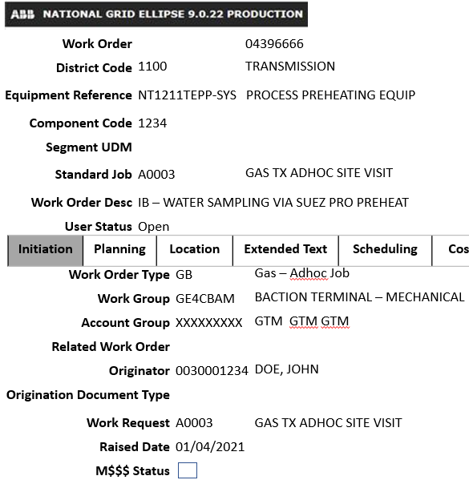
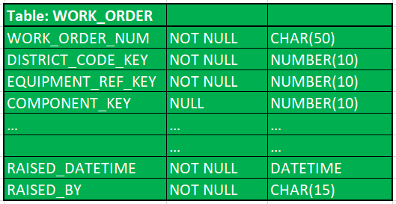
Example: UK Ellipse Work Order
Work Order Database Table
Work Order Table Data
Legend
Transaction Structure Data
Transaction Activity Data
Reference Data
Transaction Audit Data
Metadata

Slide 11
03
What is Master Data Management?

Slide 12
Master Data Management (MDM)
Master Data Management
(MDM)
Governance
Policies
Processes
Tools
Ownerships
&
Stewardships
Standards
MDM is a set of policies, standards, processes, governance, stewardships, and tools that combined create a commonly trusted, consistent, accurate, and controlled set of “master data” for critical business from across internal and external data sources and applications
With master data management, National Grid will have an authoritative and reliable source of business critical master data that will help better decision making and will support regulatory requirements, Business Analytics and Digital Transformation
Core master data entity includes Customer, Workforce, Asset, Location, Product, Vendor, Reference etc.

Slide 13

Master Data Management Architecture Vision
03
04
DEFINED BUSINESS RULES &
CONTROLS
TRUSTED GOLDEN RECORD
Have a defined master record for each data domain with a unique immutable identifier. Built from an aggregation of source info
Documented business rules in place in order to derive what information should be classed as master and have the ability to handle exceptions.
02
05
OWNERSHIP &
GOVERNANCE
SINGLE MASTER DATA
SOURCE FOR
CONSUMERS
Clear ownership of each data domain controlling access and changes to structure. Agreed group acting as data stewards
Accurate and Consumable Master Data
Have one trusted repository for all master data with pointers to relevant source system for related transactional data
01
06
DEFINED DATA MODEL
PROVIDE API SERVICES
ABSTRACTING AWAY FROM
SOURCE SYSTEMS
Aligned Enterprise, Conceptual, Logical and Physical data models.
Move away from point to point integrations and surface services through an API management layer

Slide 14
Master Data Management High Level Architecture

Slide 15
MDM implementation Style
1. Registry
Build an MDM index with limited key identifier fields and the full data stays in source system
Pros:
Less intrusive as no impact to source systems
Quick and inexpensive to set up
Cons:
Complex to build 360 view if more source systems
Require most MDM configuration
Requires retrieving master data from the source systems
Possible NG use cases:
When only one or two source systems for system of record/truth
Build an MDM centralized repository with curated master data, allow data stewards to correct data in the MDM tool. Cleansed master data is not sync up with source systems
Pros:
Less intrusive as no impact to source systems
Quick and inexpensive to set up
MDM is a repository for Golden master record
Standard MDM Configuration
Cons:
Possible to have data discrepancies between source systems and the MDM tool
Requires manual updates in source systems for data quality issues
Possible NG use cases:
When multiple source systems and they are not able load cleansed data automatically
2. Consolidating

Slide 16
MDM implementation Style
3. Co-Existence
Build an MDM centralized repository with curated master data, allows Data Steward to correct data in the MDM tool, cleansed master data is synced with source systems
Pros:
Cleanse master data are in sync between MDM and source systems
Standard MDM Configuration
Cons:
More intrusive as impacts source systems
Possible NG use cases:
When multiple source systems and systems can load/take cleansed data automatically
No source system so MDM tool is the source of record
Pros:
MDM is the system of truth and source system
Cons:
Most intrusive as MDM becomes source system
Most MDM configuration
Possible NG use cases:
When there is no source systems e.g. Reference data like Postal data
4. Transaction/Centralized

Slide 17
Benefits of Master Data Management
Creates centralized multi domain data repository by creating golden master records
Creates an enterprise unique persistent identifier for each master data domain
Avoids data duplication
Increases data accuracy
Improves data quality
Improves data consistency and data standardization
Provides better data compliance
Enables data governance and data stewardship
Offers better secure data access
Provides an API service for consumers of this curated data

Slide 18
Master Data Management Use Cases
Use Case | Benefit
MDM1 – Centralized data repository for multi-domain master data | All master data from multiple domains in one place, one governance and shared enterprise control process
MDM2 – System of record for unique enterprise persistent identifier for each master data entity | MDM can create a single unique identifier for each master data entity like Worker, Position, Customer, Asset, and Location etc. that is required by multiple business processes
MDM3 – Allow data quality improvements, remove data duplication, and allow data steward to see data issues and help them correcting them | Consistently maintain data quality and remove duplicate records of the Worker, Position, Customer, Asset, and Location master data entities
MDM4 – Create and maintain golden record of master data and sync cleanse and standardise data back to source systems of record | Remove data discrepancy between different source systems and have an authoritative and a reliable source of Customer, Workforce, Asset master data that solves the one biggest pain point of multiple business areas
MDM5 – Source for Master data for Common Enterprise API/Services, MuleSoft, EDP/Data Lake, or any other downstream systems and improve performance by reducing dependency of source systems | Consistent clean accurate master data for Common Enterprise API/Services, MuleSoft, EDP/Data Lake, or any other downstream systems

Slide 19
04
Roadmap

Slide 20
Data Capability Enablement Tools Roadmap (as of Feb 2021)
Research Initiated
Tool(s) Selected
ITGC Approved
Capability available
Expected GA
Actively Deployed
2020
2021
Q1
Q2
Q3
Q4
Jan
Feb
Mar
Q2
Q3
Q4
Data Analytics & Reporting – Power BI
Data Modeling - ER/Studio
Enterprise Data Analytics Platform – Snowflake
Master Data Management – Finalized end of Feb
Data Quality, Data Catalog, Data Governance - Informatica
Data Integration & Orchestration – Matillion in final vetting
Advanced Analytics, Machine Learning & AI - TBD

Slide 21
Master Data Management Proposed Roadmap (Draft)
Tools
2020
2021
2022
Aug
Sept
Oct
Nov
Dec
Jan
Feb
Mar
April
May
June
Jul
Aug
Sept
Oct
Nov
Dec
Jan
Feb
Consolidate MDM
Use Cases/Capabilities
Start Security Commercial
Complete Security Assessment, Contact & Get Funding
MDM Tool
Complete US Cust
& WF Assessments
Select top 2 tools
Select
The Tool
MDM Environment
Ready to use
US Customer
Master Data
Transitional Interim EDP Release 1-3
Approve
Funding
MDM
Pre-work
MVP
Release 4
MVP
Release 5
MVP
Release 6
US Asset
Master Data
Pre-work
Approve
Funding
MVP
Release 1
MVP
Release 2
Global Workforce
Master Data
Approve
Funding
Pre-work
MVP
Release 1
MVP
Release 2
MVP
Release 3
UK Asset
Master Data
Approve
Funding
Pre-work
MVP
Release 1

Slide 22
UK Asset MDM Proposed Roadmap (Draft)
2022
2023
Jan
Feb
Mar
April
May
June
Jul
Aug
Sept
Oct
Nov
Dec
Jan
Feb
Mar
April
May
June
MDM Tool
MVP
Release 1
MVP
Release 2
MDM tool
Ready to use
Pre-work
MDM/DQ/DG
Approve
Funding
Asset Data model, Master Record, Profiling, CDC,
Business Rules/Requirement
MVP – Persistent Unique ID, Key Location and Asset fields
Remaining Asset and Location
Master Data
Source System Integration
Approve
Funding
Sync Persistent Unique ID, Key Location and Asset fields to Source Systems
Sync remaining Location and Asset master data to Source Systems
CDP (Snowflake)
Approve
Funding
Asset and Location Master Data sync
Other System Integration
Approve
Funding
tbd
Note:
Scope of each release will be finalized as per pre-work findings
Future Release timeline will be changed based on the current release date change
Each release pre-work will start ahead of the time

Slide 23
Master Data Management Vendors/Tools
Finalists
Informatica MDM
AWS, GCP, and Azure based single-tenant SaaS solution
Reltio
100% cloud native
AWS and GCP based multi-tenant SaaS solution (Azure support in Q2/Q3 2021)
Following 2 vendors are eliminated after first round
Riversand
100% cloud native
Azure based multi-tenant SaaS solution
WinShuttle Enterworks
No SaaS solution
PaaS solution available

Slide 24


